Slide 1
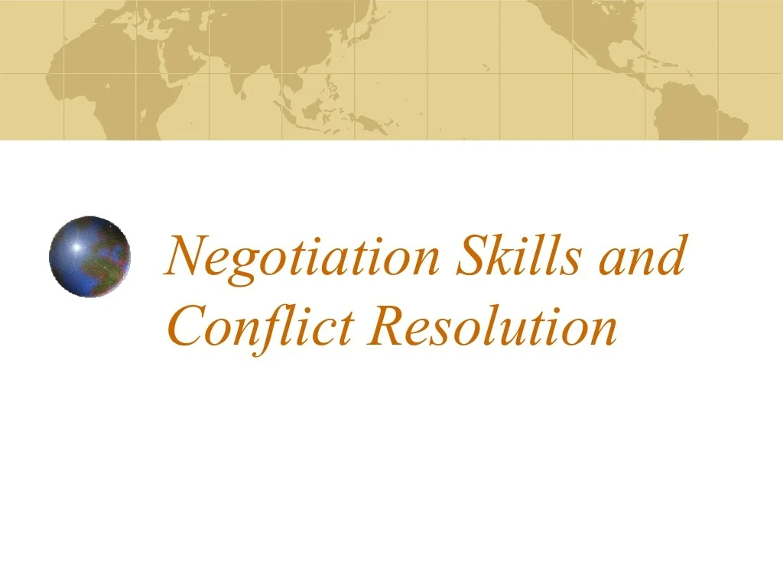

Slide 2
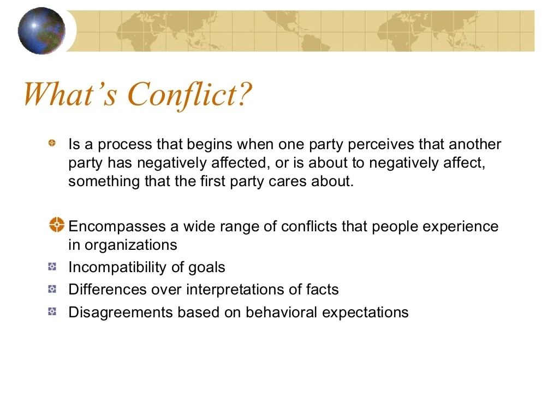

Slide 3
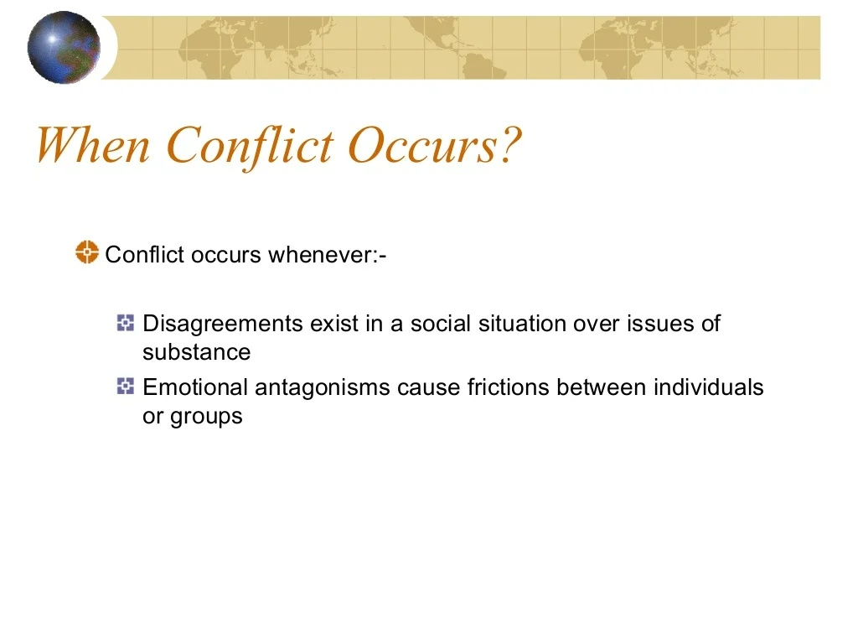
Notes:
It is antagonistic emotions that figure most prominently among political emotions: distrust, envy, fear, anger, resentment, indignation, contempt, or hatred.

Slide 4
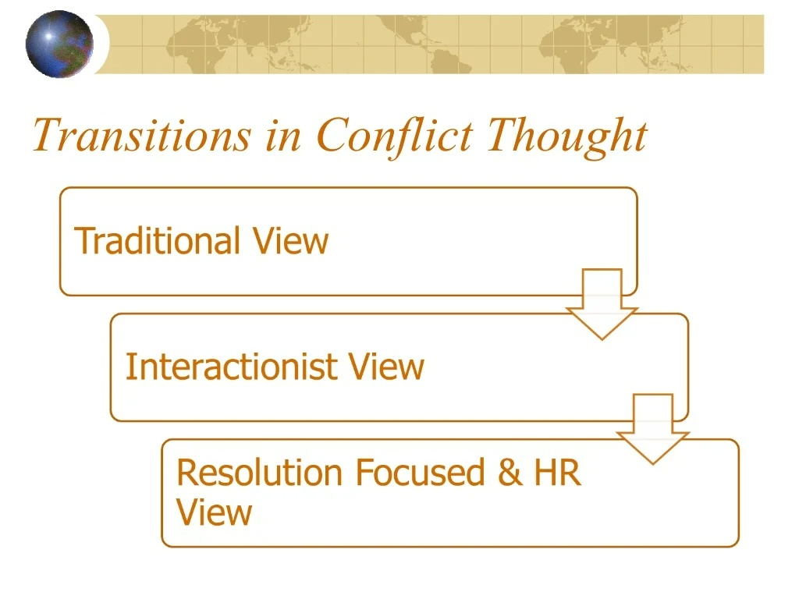

Slide 5
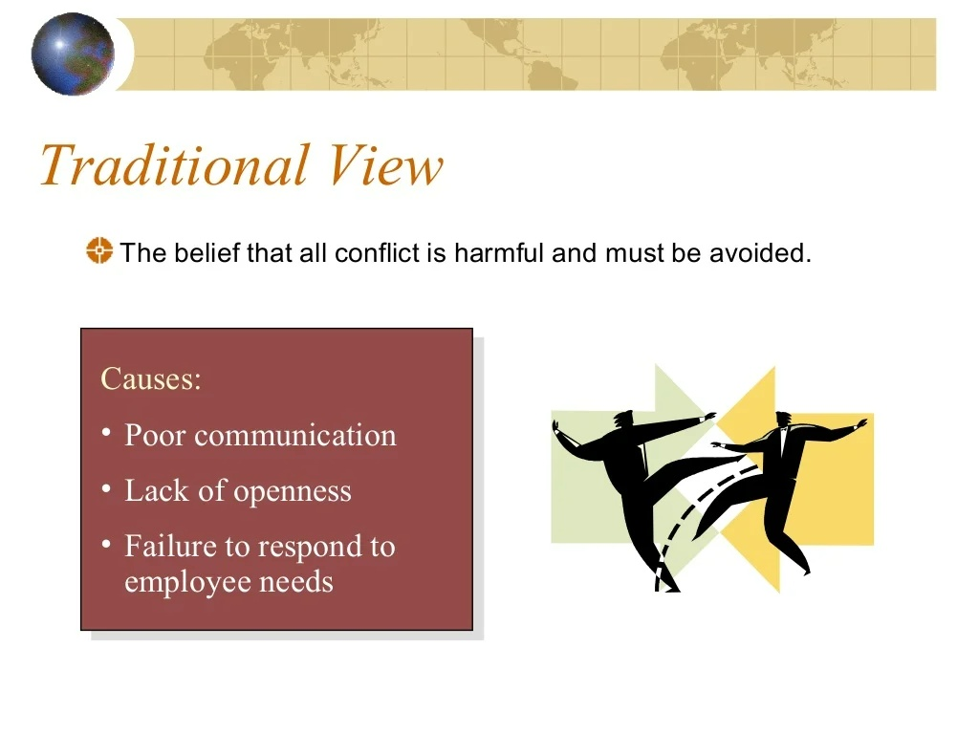
Notes:
Early in our pursuit of management study, conflict was thought to be a dysfunctional outcome, a result of poor communication and lack of trust between co-workers. Conflict was associated with words like violence and destruction, and people were encouraged to avoid it at all costs.
This was the case all the way up until the 1940s, and, if you think about it, it goes right along with what we thought we knew about what motivated people, how they worked together and the structure and supervision we thought we needed to provide to ensure productivity. Because we viewed all conflict as bad, we looked to eradicate it, usually by addressing it with the person causing it. Once addressed, group and organization would become more productive again.
Many of us still take the traditional view—conflict is bad and we need to get rid of it – even though evidence today tells us that’s not the case.

Slide 6
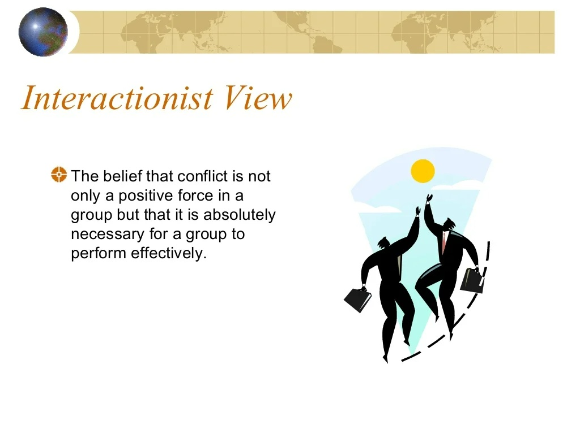
Notes:
In the Interactionist View of conflict, we went from accepting that conflict would exist and dealing with it to an understanding that a work group that was completely harmonious and cooperative was prone to becoming static and non-responsive to needs for change and innovation. So this view encouraged managers to maintain a minimal level of conflict, a level that was enough to keep the group creative and moving forward.
The Interactionist View is still viable today, so it’s the view we’re going to take from here on as we discuss conflict. We know that all conflict is both good and bad, appropriate and inappropriate, and how we rate conflict is going to depend on the type of conflict. We’ll discuss types of conflict next.

Slide 7
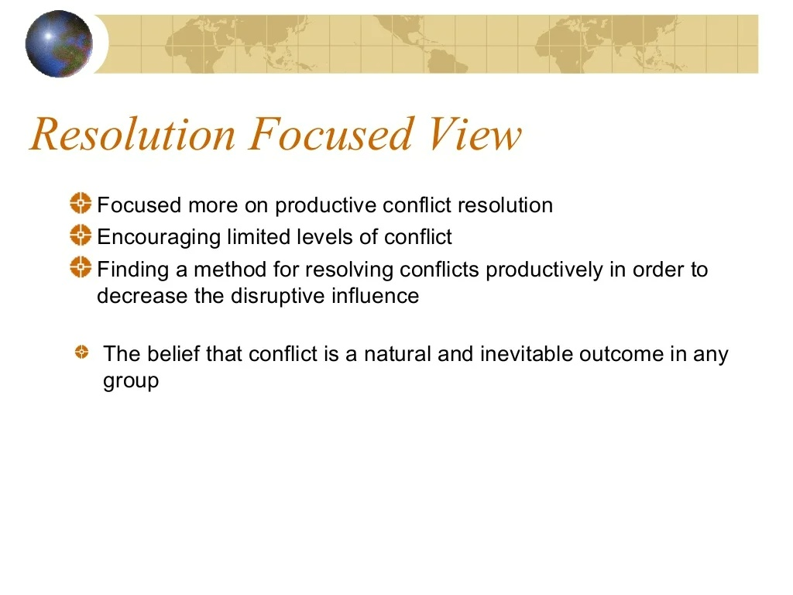

Slide 8
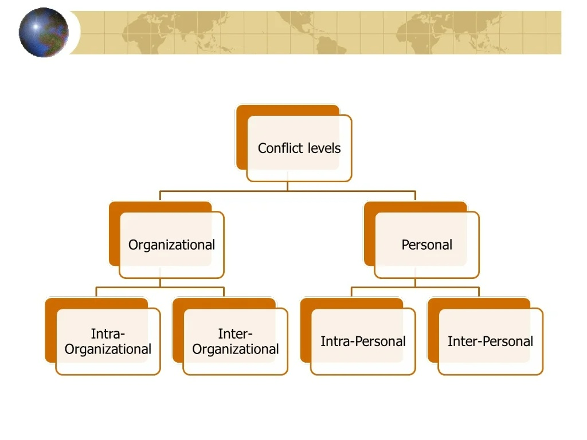

Slide 9
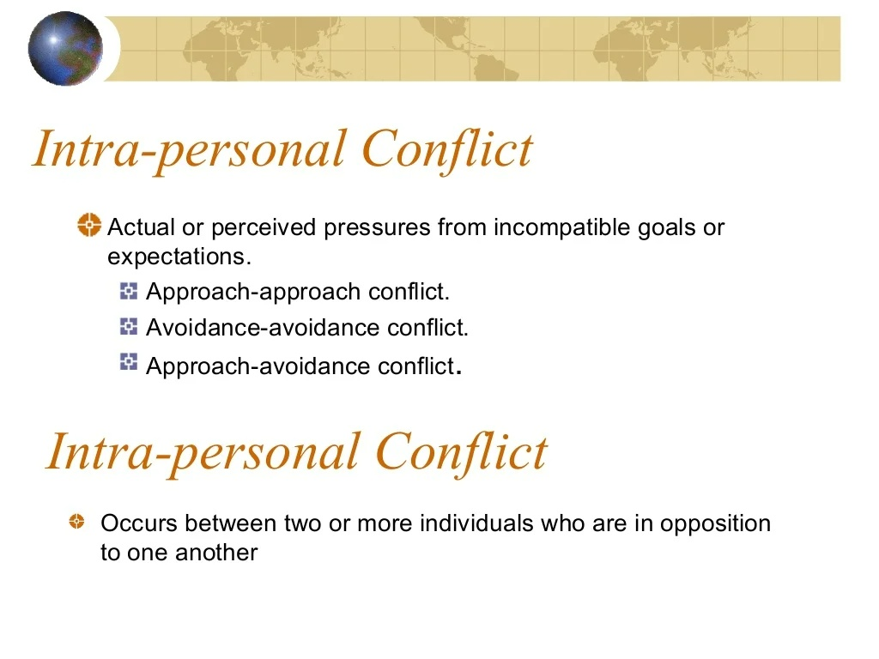
Inter

Slide 10
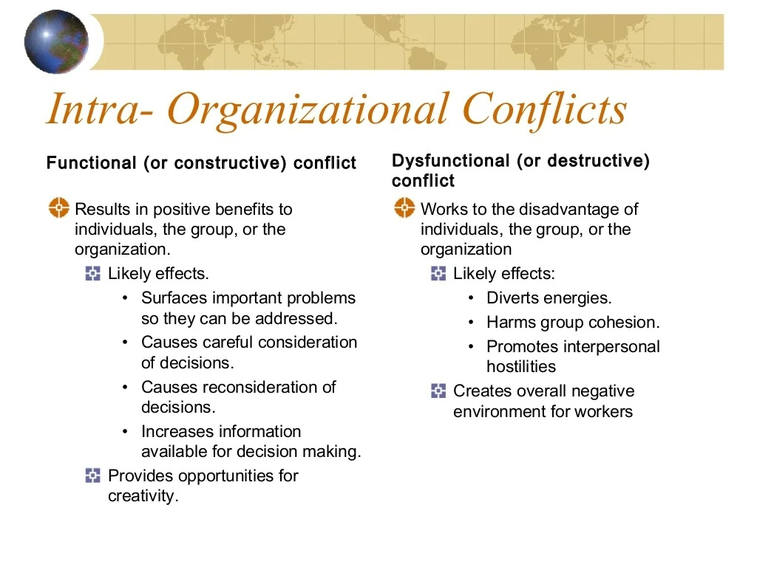

Slide 11
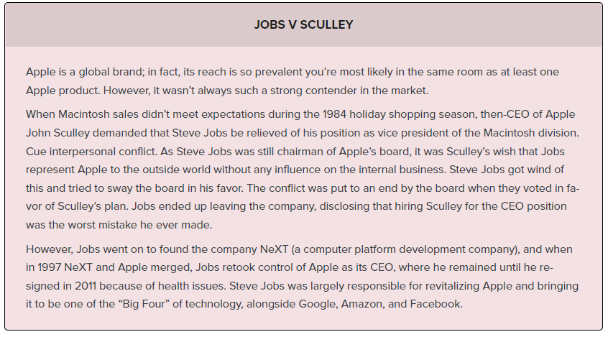

Slide 12
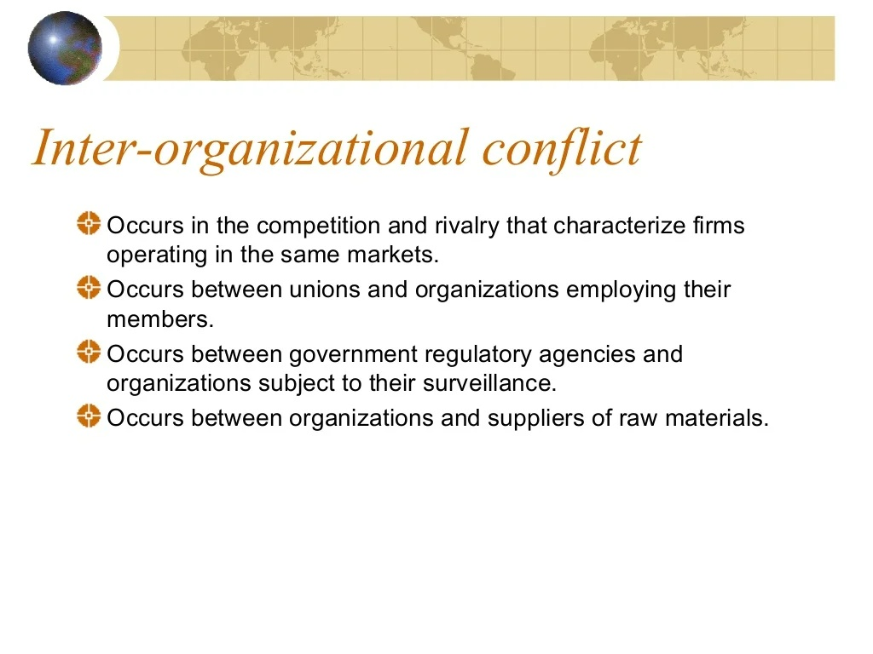

Slide 13
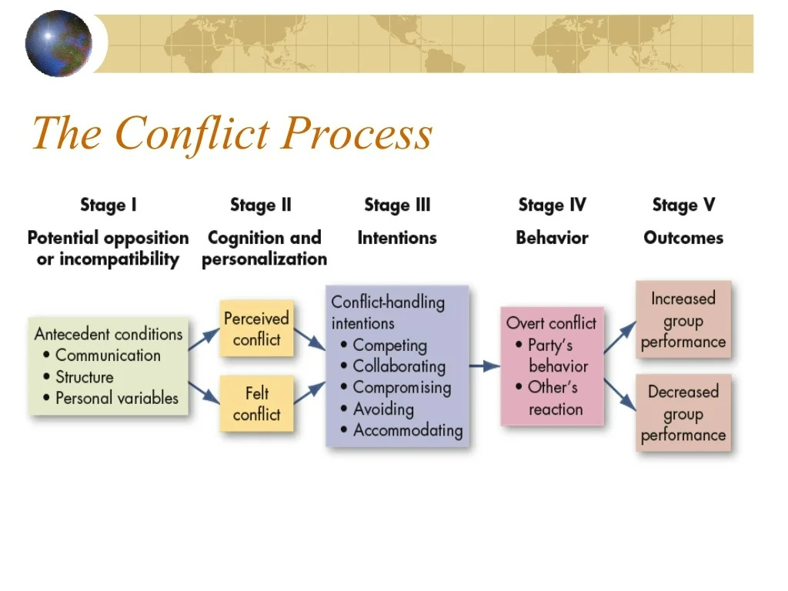

Slide 14
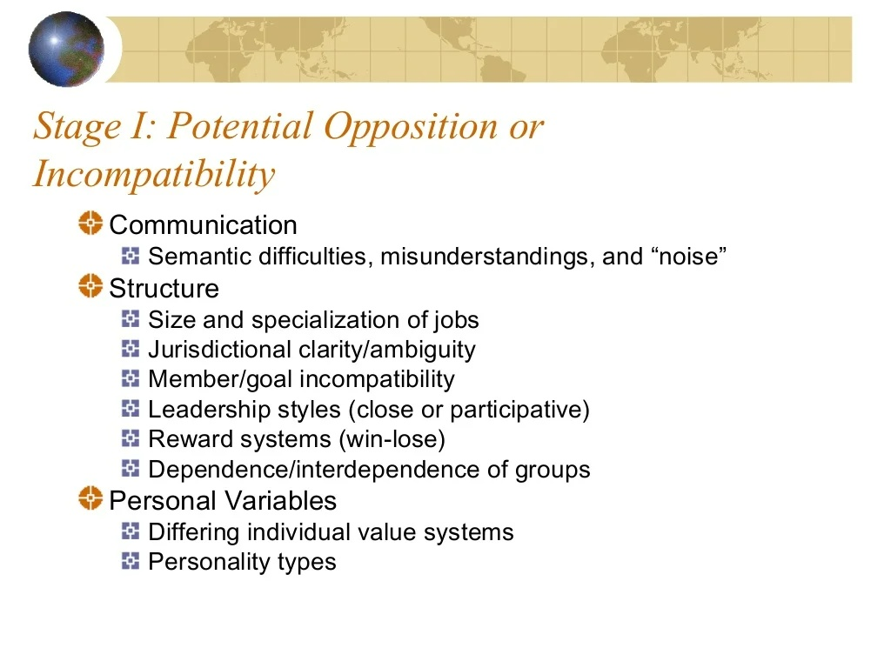
Notes:
The first stage in the conflict process is the existence of conditions that allow conflict to arise. The existence of these conditions doesn’t necessarily guarantee conflict will arise. But if conflict does arise, chances are it’s because of issues regarding communication, structure, or personal variables.
Communication. Conflict can arise from semantic issues, misunderstanding, or noise in the communication channel that hasn’t been clarified. For instance, your new manager, Steve, is leading a project and you’re on the team. Steve is vague about the team’s goals, and when you get to work on your part of the project, Steve shows up half the way through to tell you you’re doing it wrong. This is conflict caused by communication.
Structure. Conflict can arise based on the structure of a group of people who have to work together. For instance, let’s say you sell cars, and your co-worker has to approve the credit of all the people who purchase a vehicle from you. If your co-worker doesn’t approve your customers, then he is standing between you and your commission, your good performance review, and your paycheck. This is a structure that invites conflict.
Personal variables. Conflict can arise if two people who work together just don’t care for each other. Perhaps you work with a man and you find him untrustworthy. Comments he’s made, the way he laughs, the way he talks about his wife and family, all of it just rubs you the wrong way. That’s personal variable, ripe to cause a conflict.

Slide 15
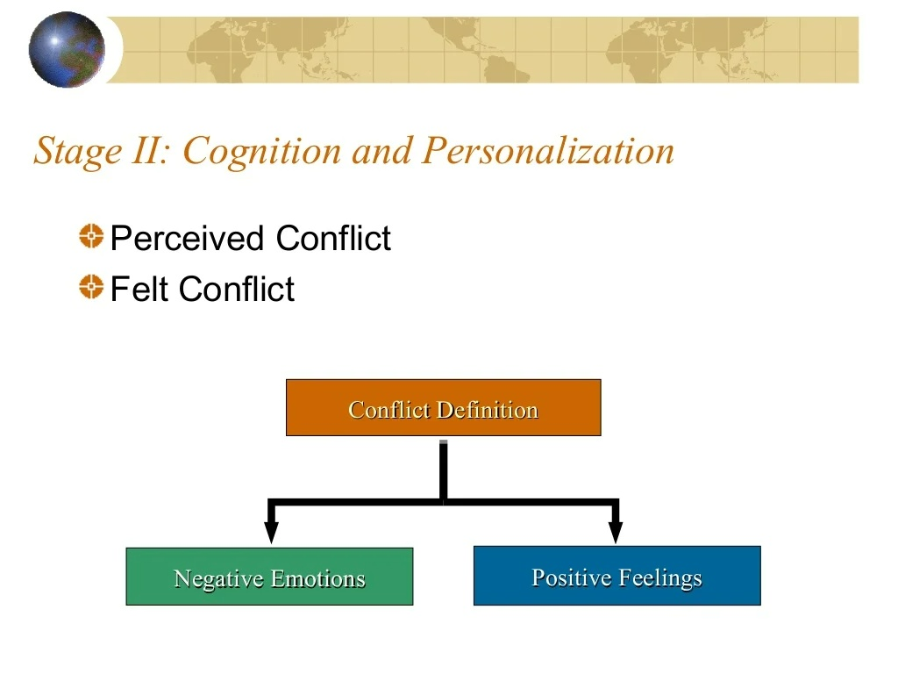
Notes:
conflict only exists if it’s perceived to exist. If it’s been determined that potential opposition or incompatibility exists and both parties feel it, then conflict is developing.
If Joan and her new manager, Mitch, are having a disagreement, they may perceive it but not be personally affected by it. Perhaps Joan is not worried about the disagreement. It is only when both parties understand that conflict is brewing, and they internalize it as something that is affecting them, that this stage is complete.

Slide 16
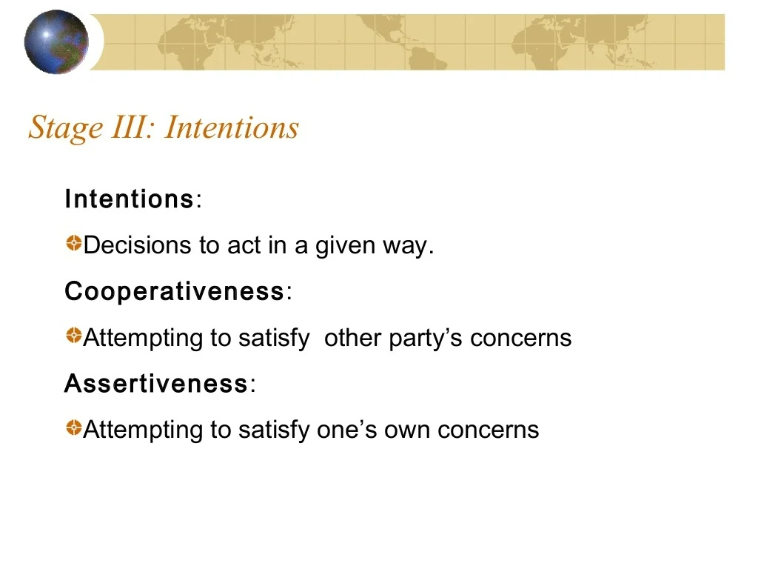
Notes:
Competing. One party seeks to satisfy his own interests regardless of the impact on the other party.
Collaborating. One party, or both, desire to fully satisfied the concerns of all parties involved in the conflict.
Avoiding. One party withdraws from or suppresses the conflict once it is recognized.
Accommodating. One party seeks to appease the opponent once potential conflict is recognized.
Compromising. Each party to the conflict seeks to give up something to resolve the conflict.

Slide 17
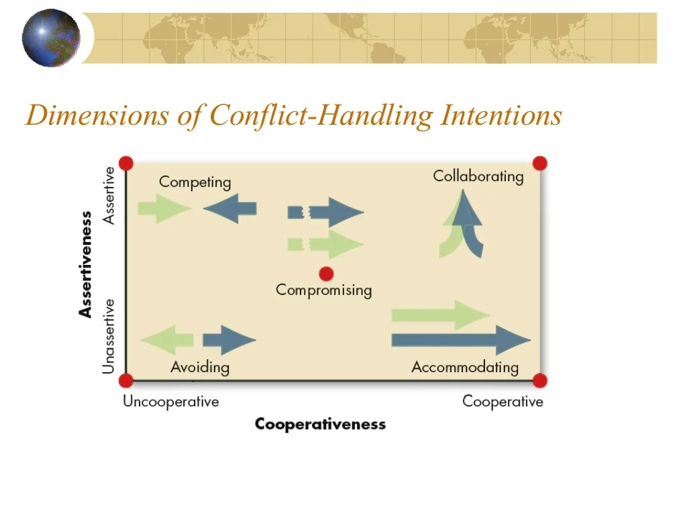

Slide 18
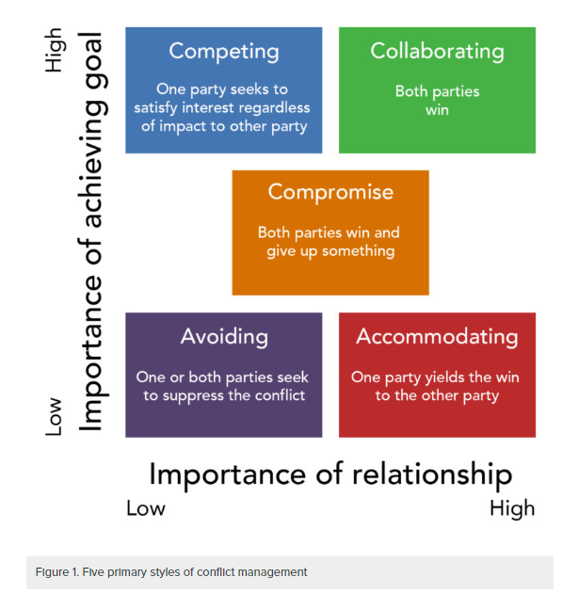

Slide 19
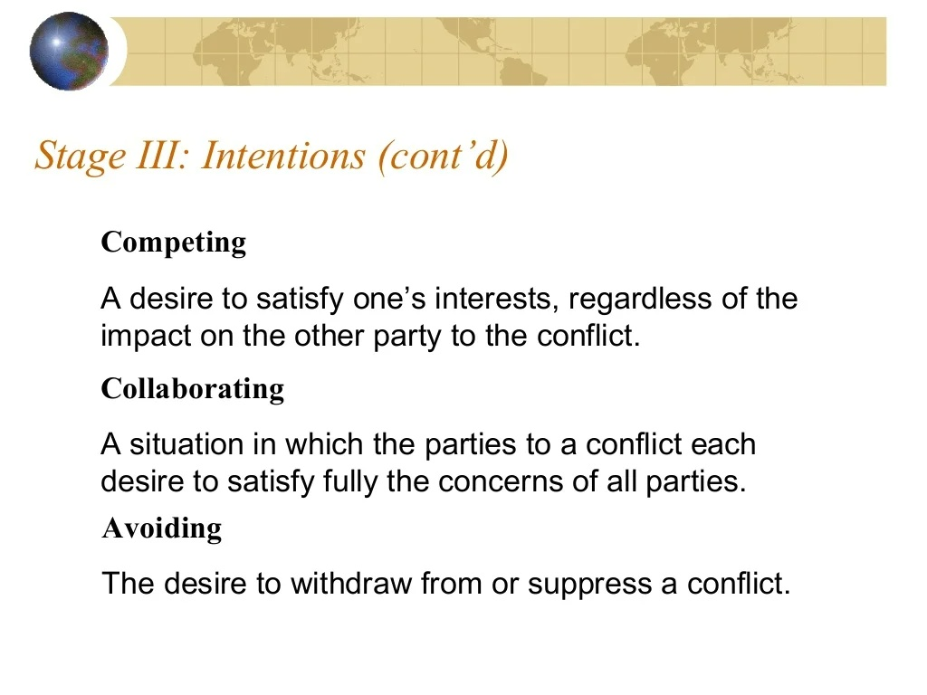

Slide 20
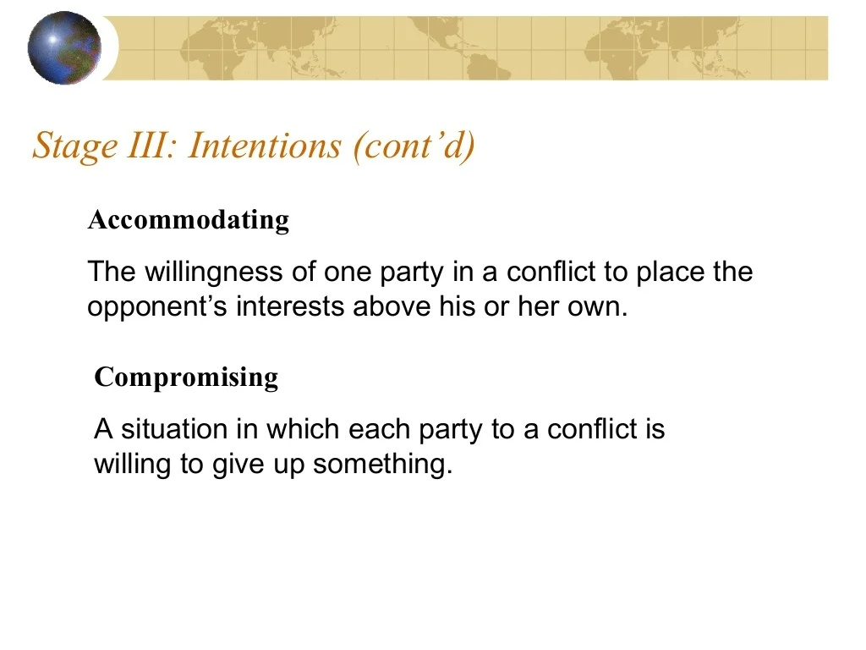

Slide 21
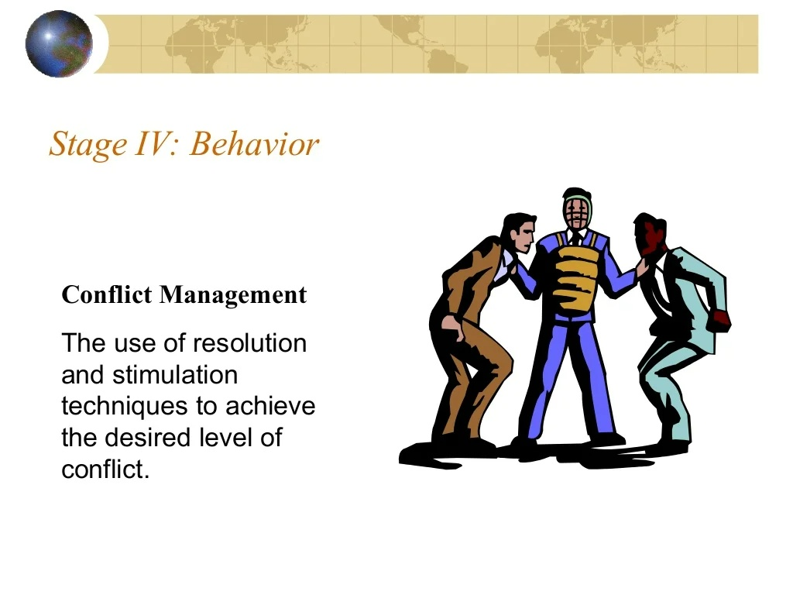
Notes:
Behavior is the stage where conflict becomes evident, as it includes the statements, actions and reactions of the parties involved in the conflict. These behaviors might be overt attempts to get the other party to reveal intentions, but they have a stimulus quality that separates them from the actual intention stage.
Behavior is the actual dynamic process of interaction. Perhaps Party A makes a demand on Party B, Party B argues back, Party A threatens, and so on. The intensity of the behavior falls along a conflict oriented continuum. If the intensity is low, the conflict might just be a minor misunderstanding, and if the intensity is high, the conflict could be an effort to harm or even destroy the other party.

Slide 22
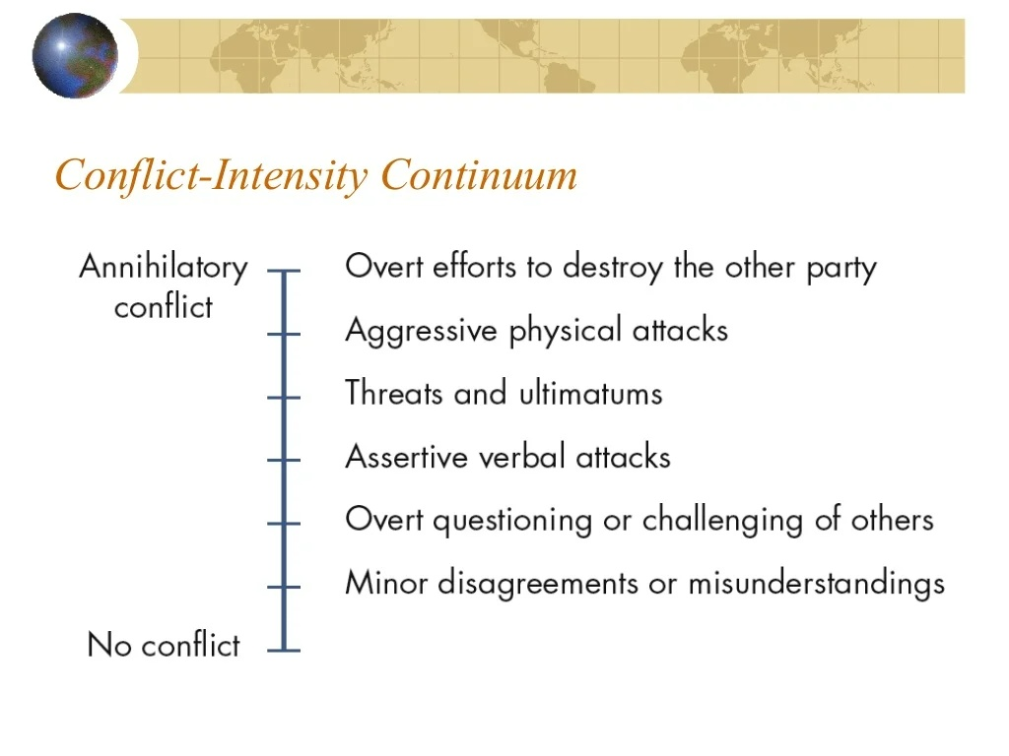

Slide 23
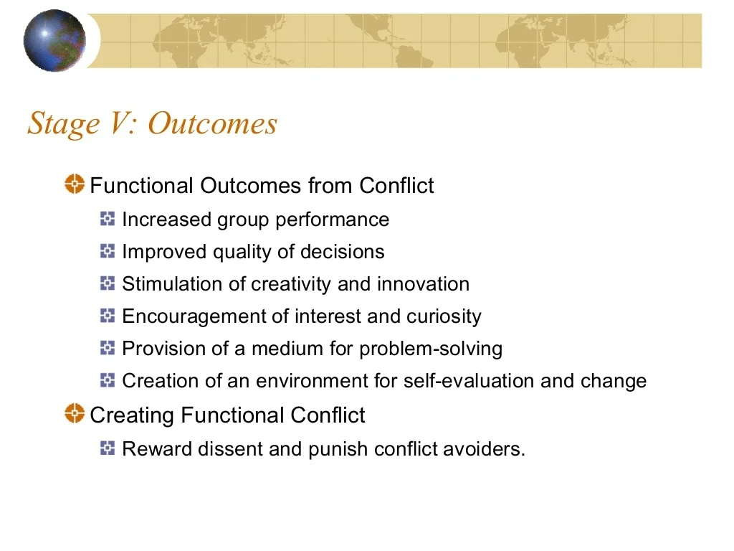

Slide 24
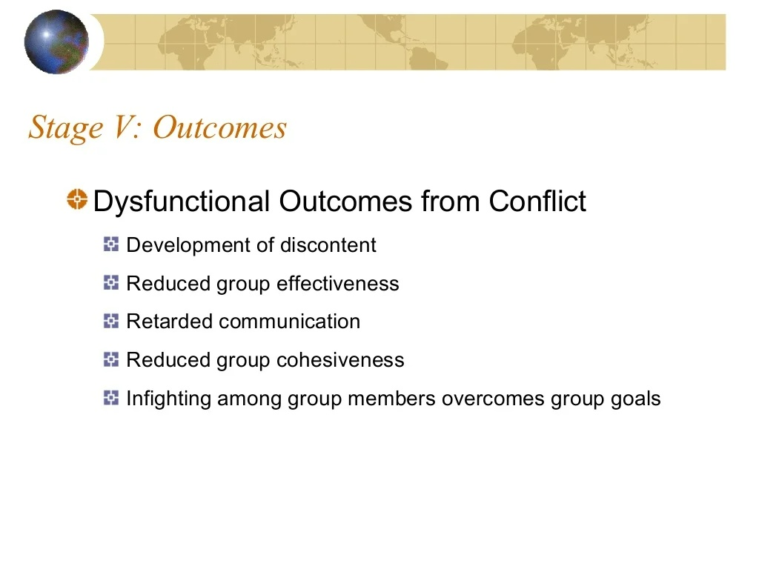

Slide 25
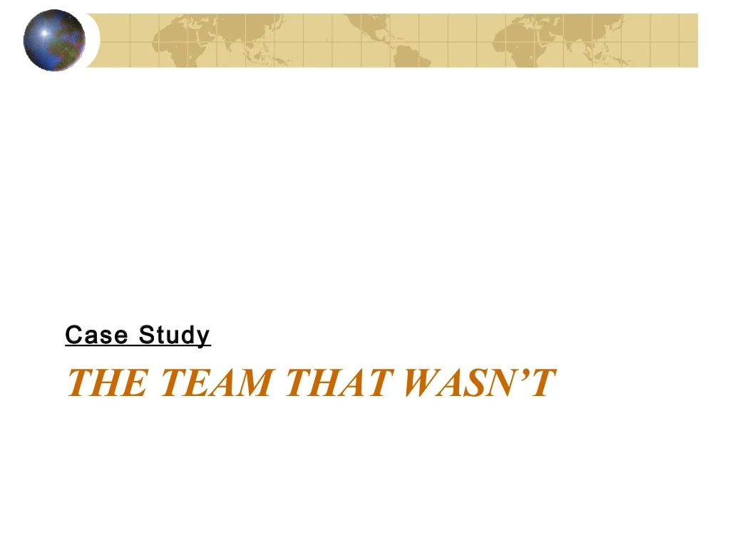

Slide 26
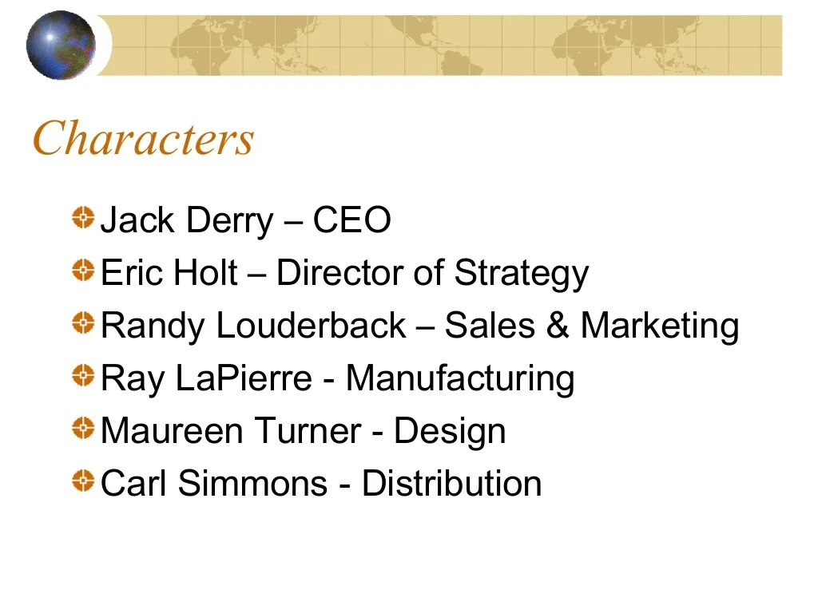

Slide 27
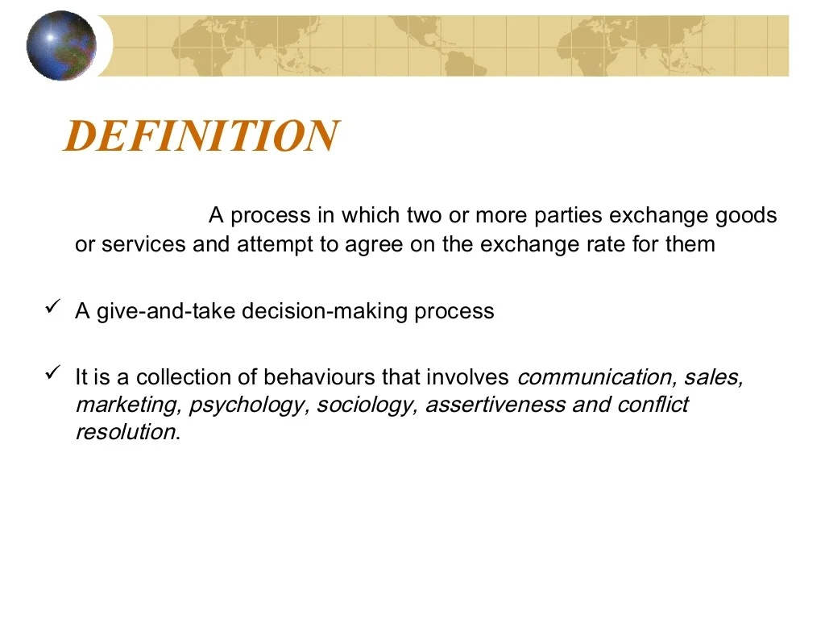

Slide 28
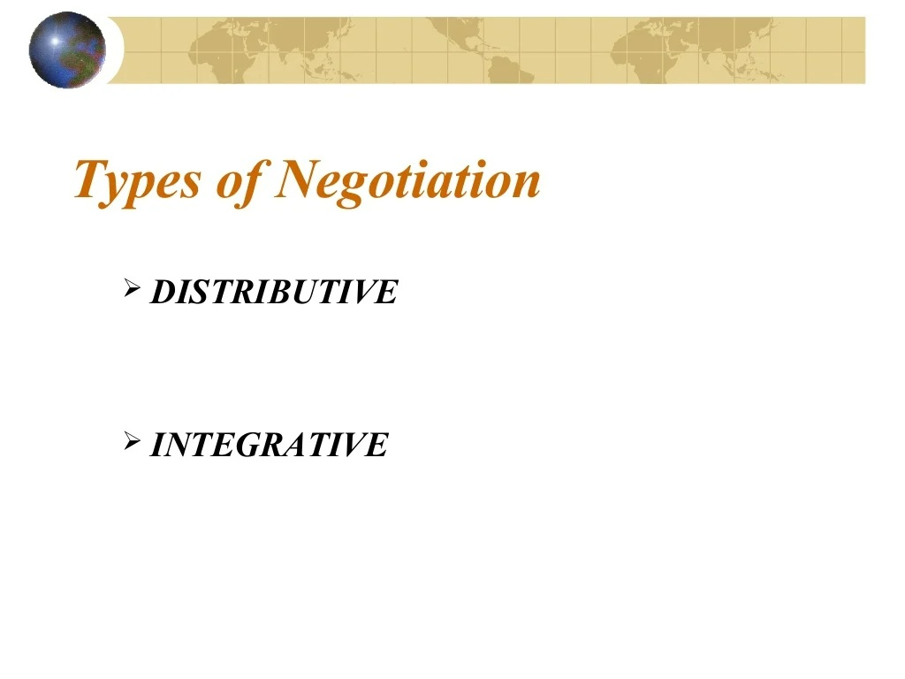

Slide 29
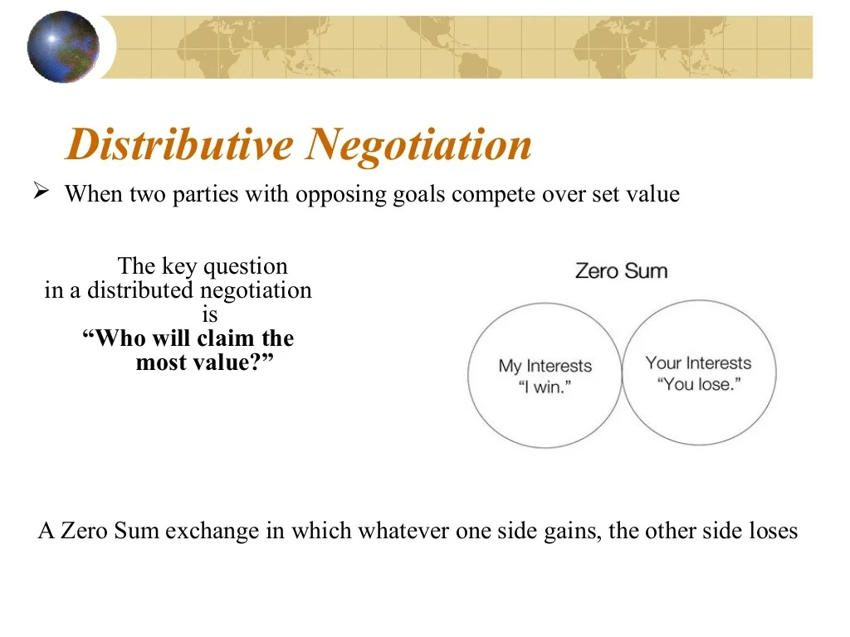
Notes:
Distributive negotiation operates under zero-sum conditions. Anything one party gains in the deal is lost by the other party. There can be a winner and a loser, and parties are usually opposing each other. Any relationship between the two parties is usually short term, as at least one party will walk away a “loser” of sorts and animosities can build.

Slide 30
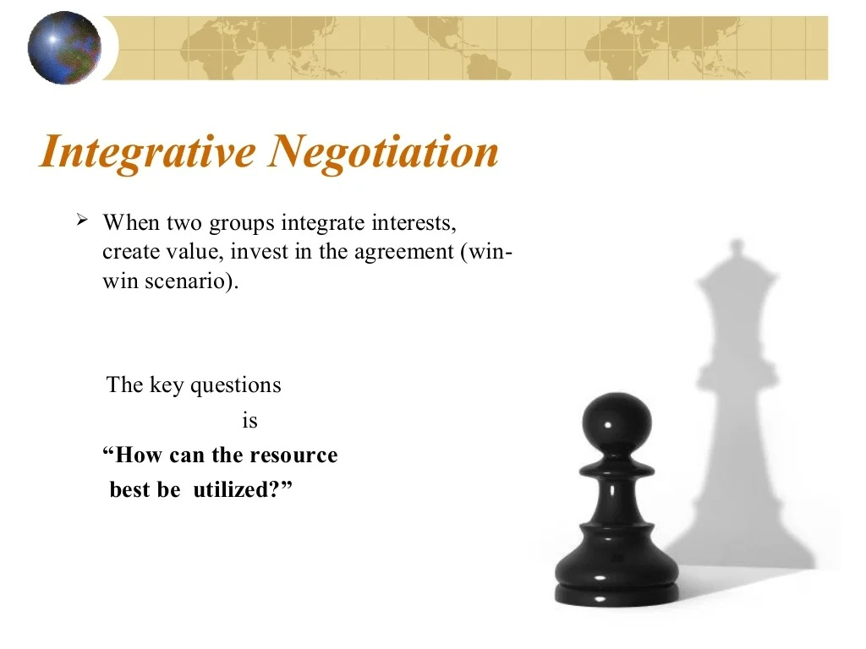
Notes:
Integrated negotiation features a variable amount of resources to be divided. In integrated negotiations, both parties can walk away winners. Their primary interests don’t make them “opposing parties,” but rather they’re convergent or congruent with one another. In integrated negotiations, the relationship can be of longer term, because feelings are preserved and no one walks away a loser.

Slide 31
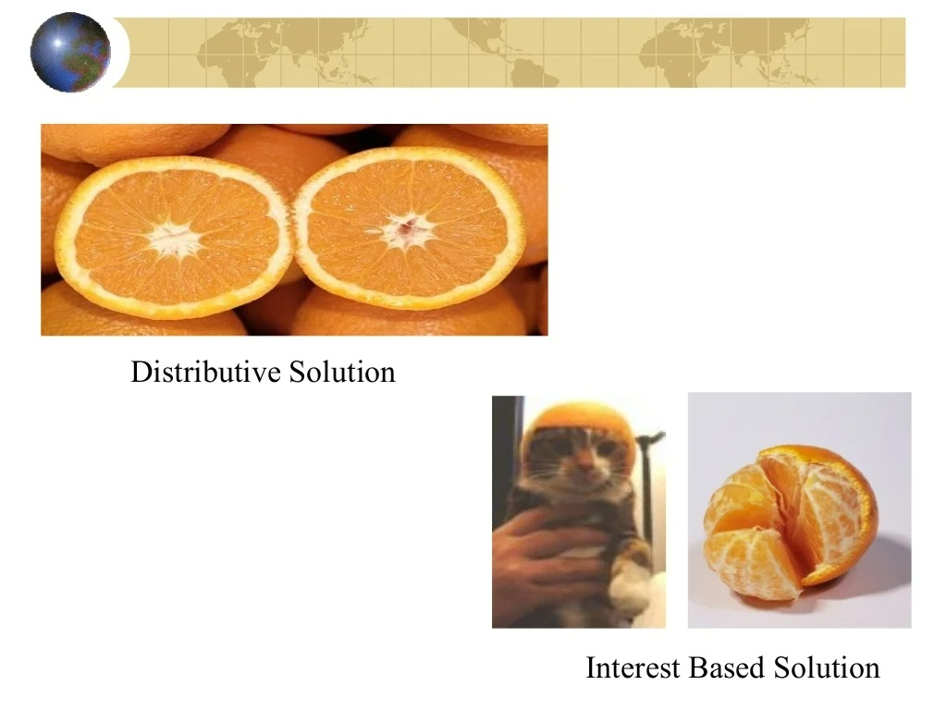

Slide 32
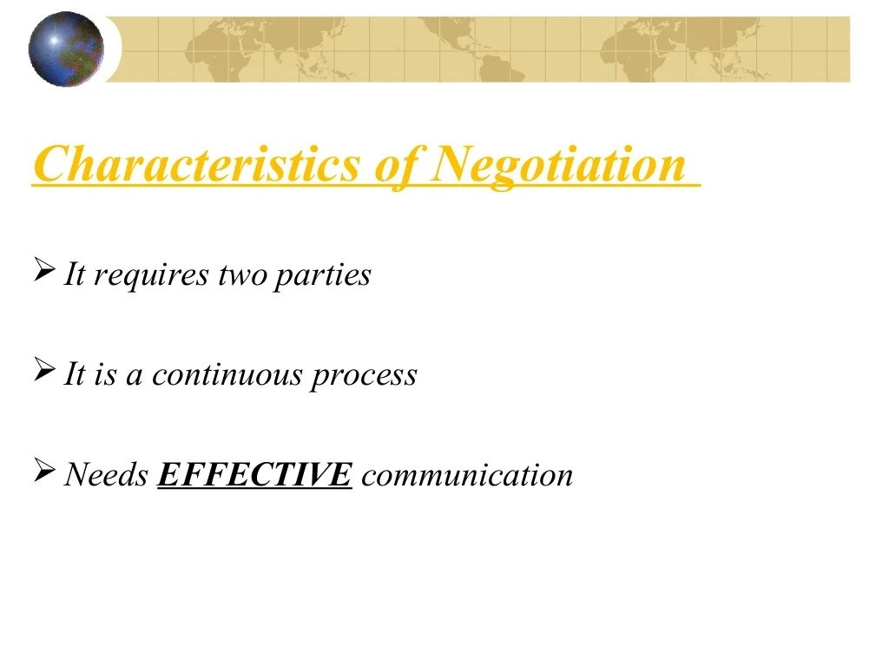

Slide 33
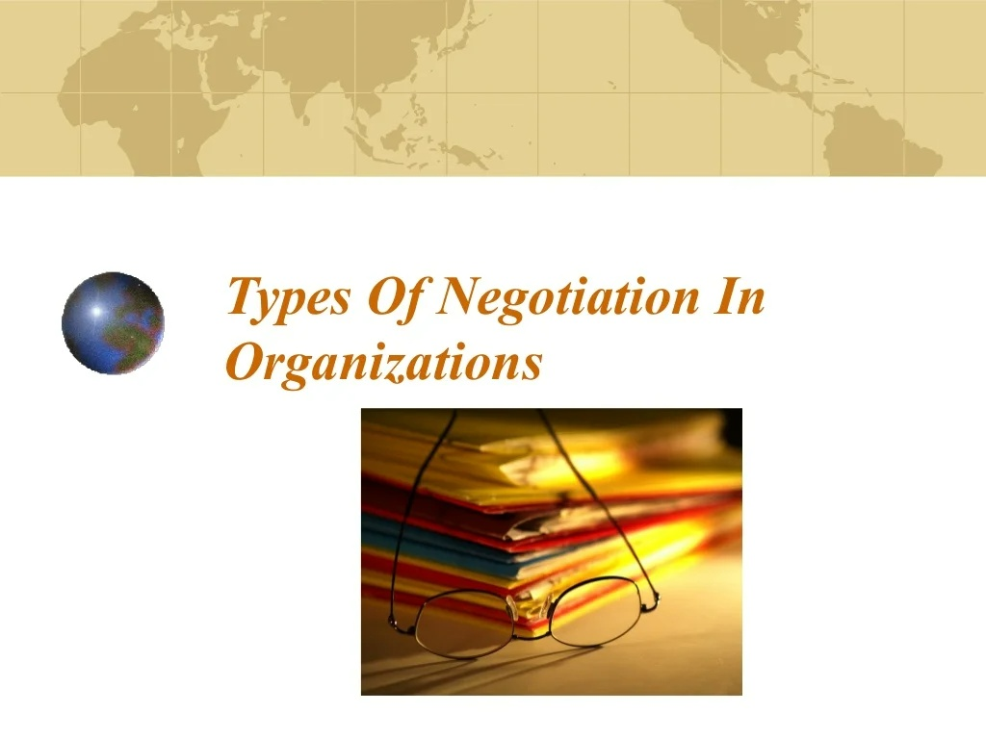

Slide 34
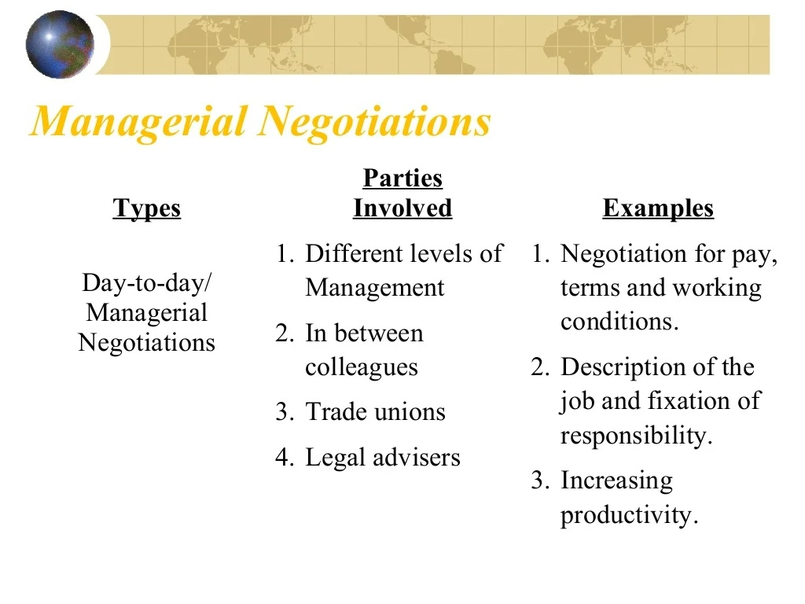

Slide 35
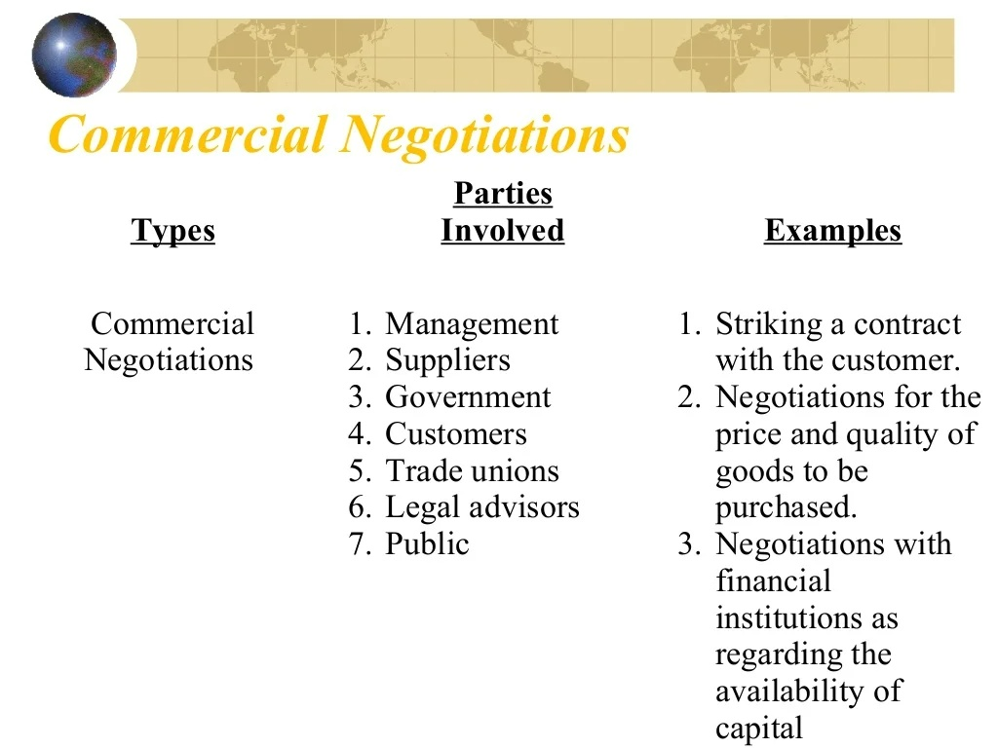

Slide 36
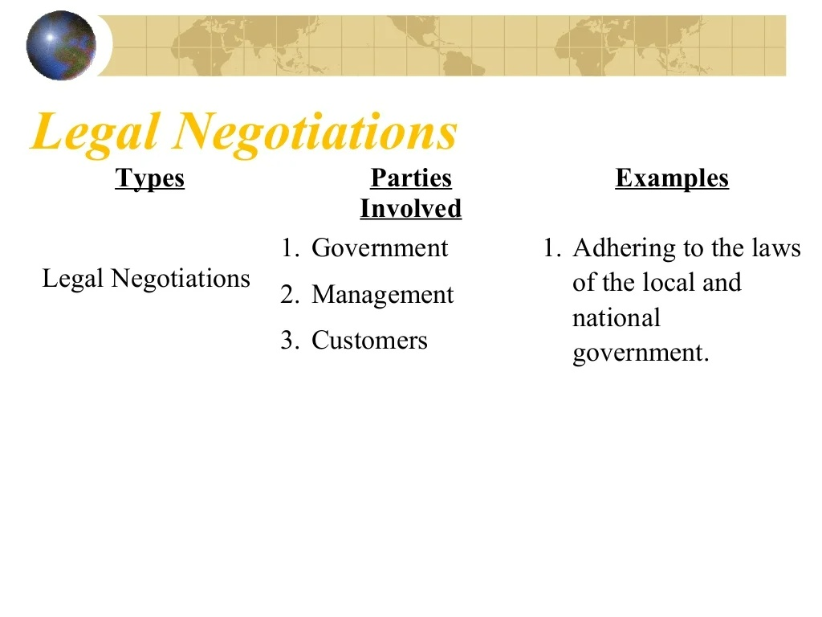

Slide 37
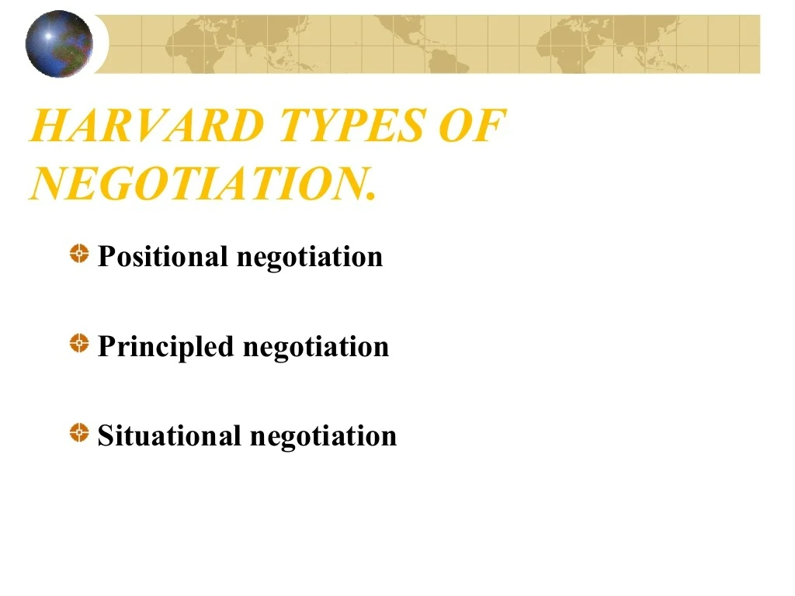

Slide 38
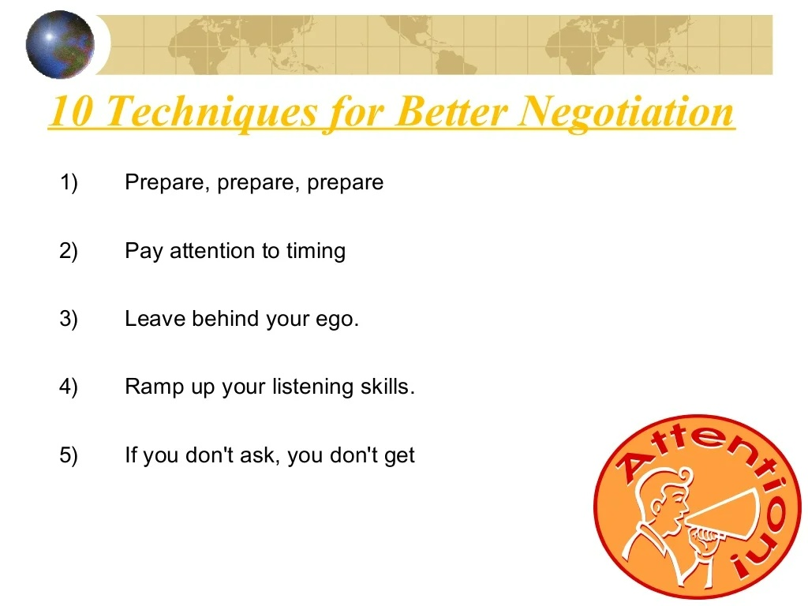

Slide 39
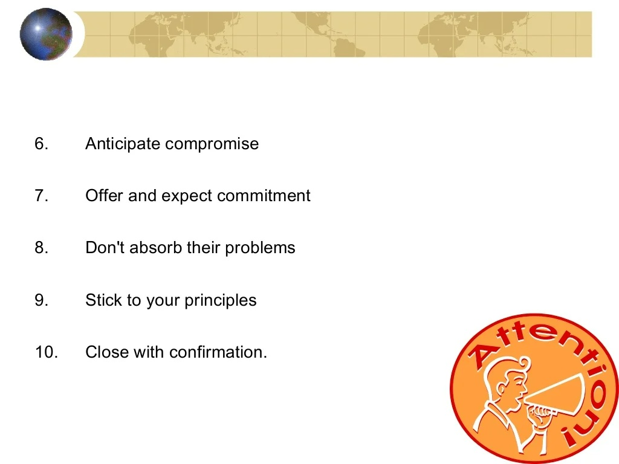

Slide 40
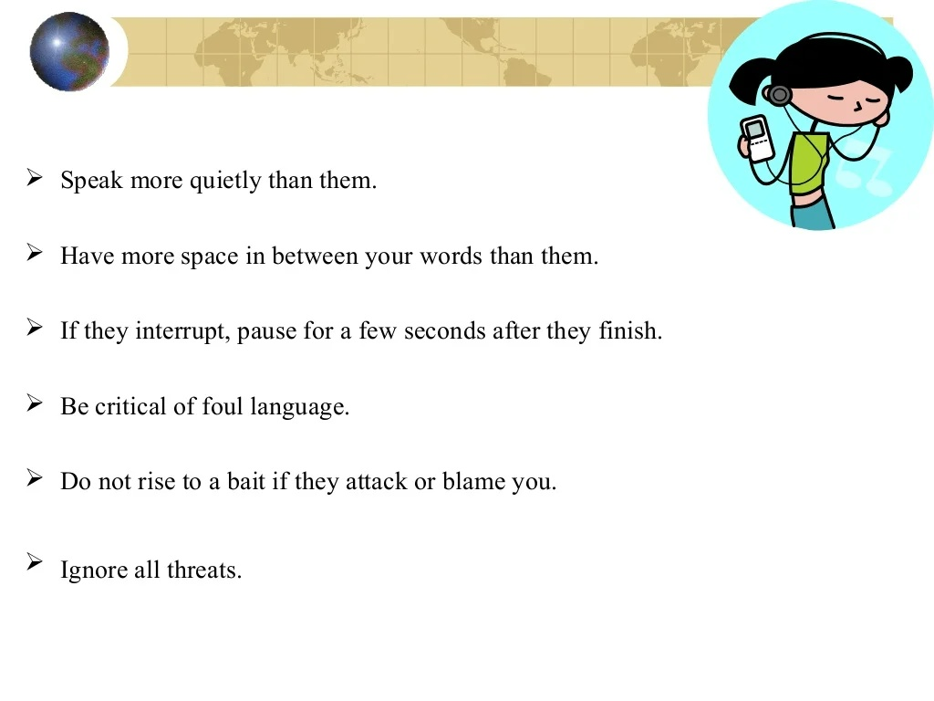

Slide 41
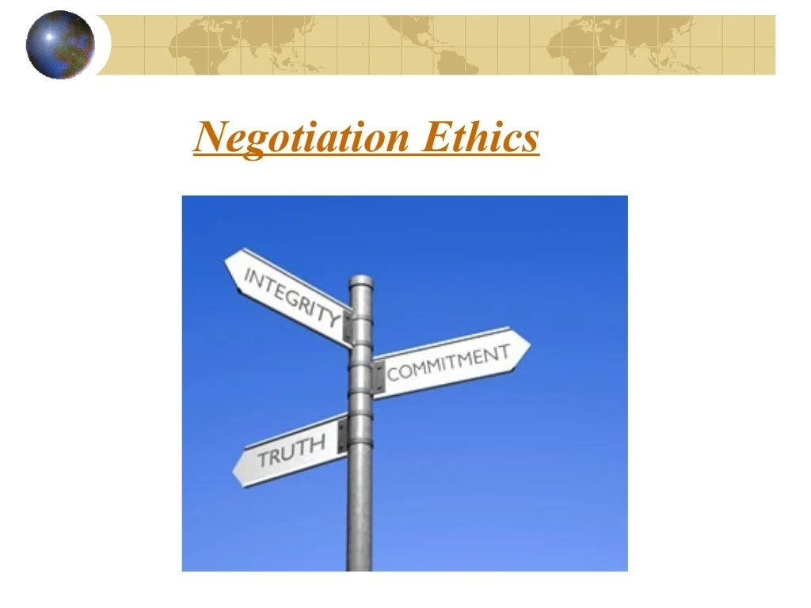

Slide 42
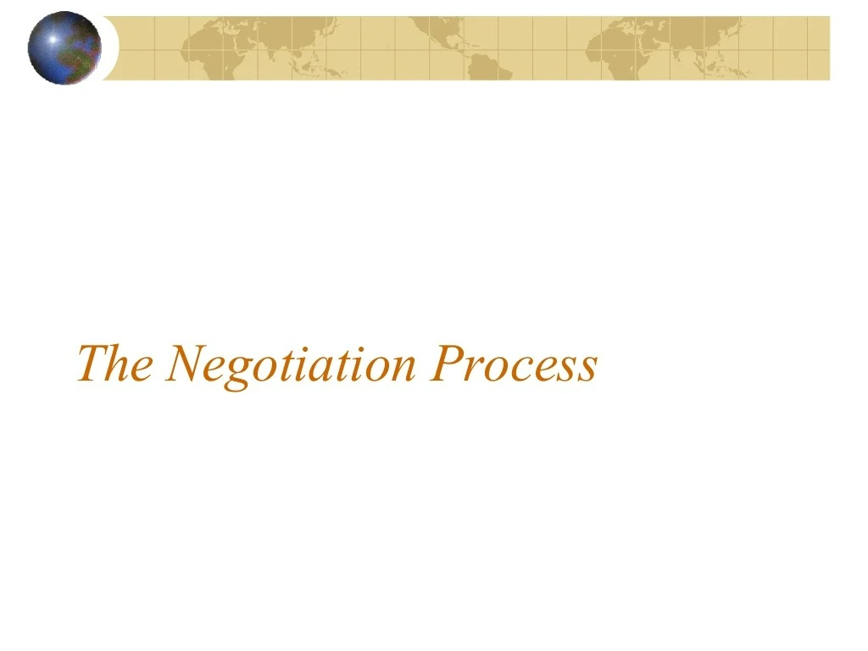

Slide 43
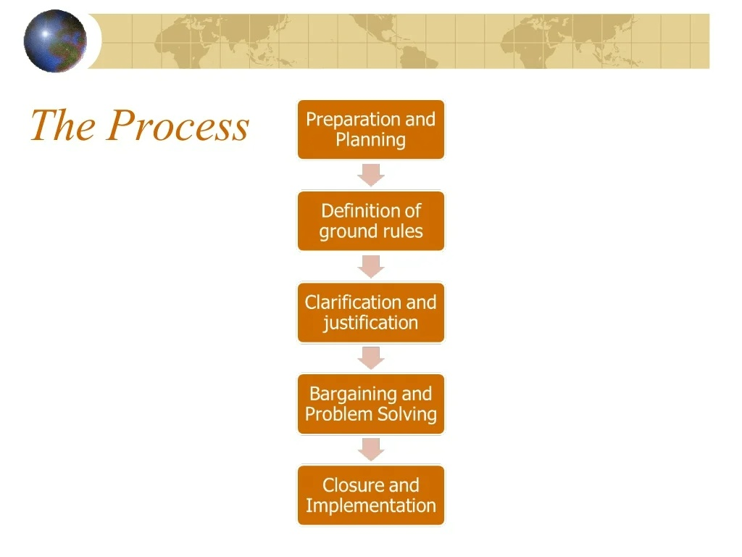

Slide 44
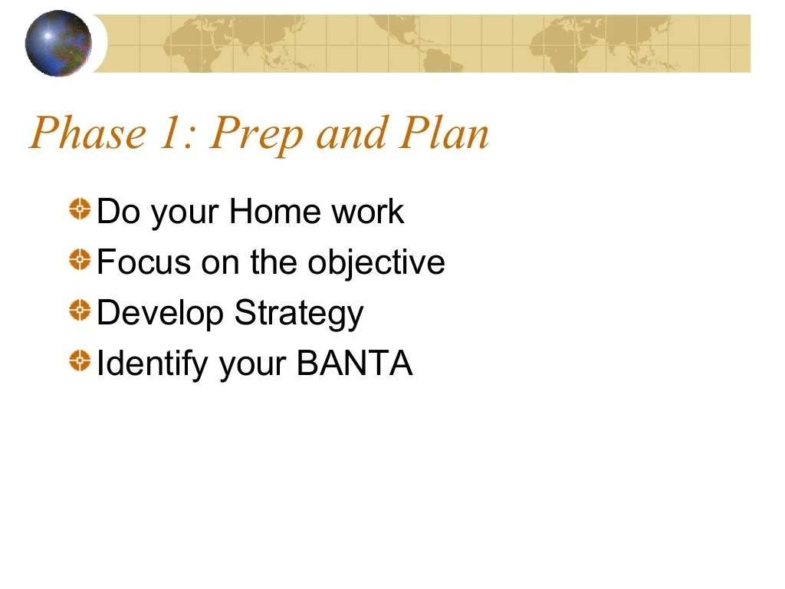
(the best alternative to a negotiated agreement)

Slide 45
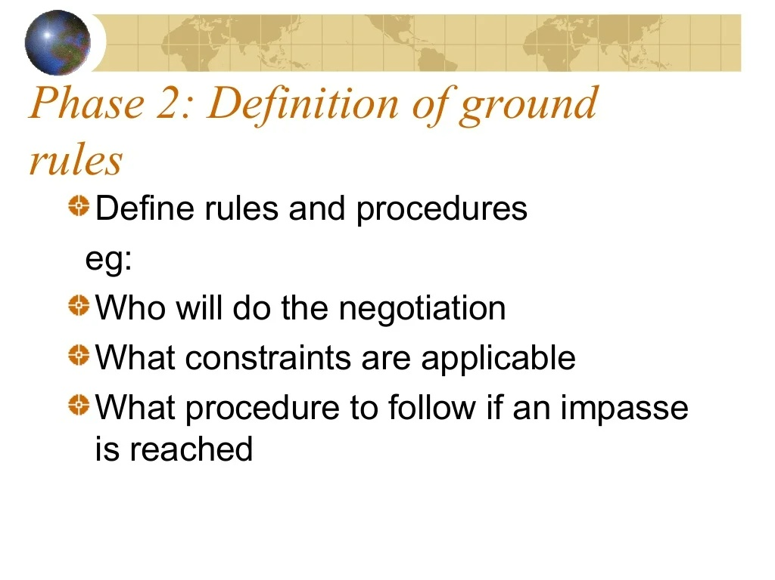

Slide 46
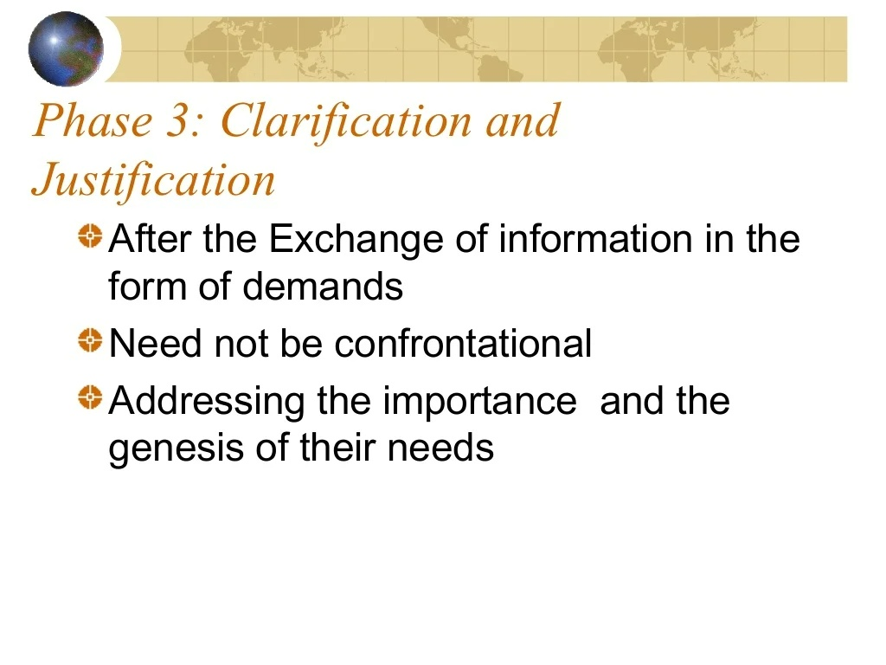

Slide 47
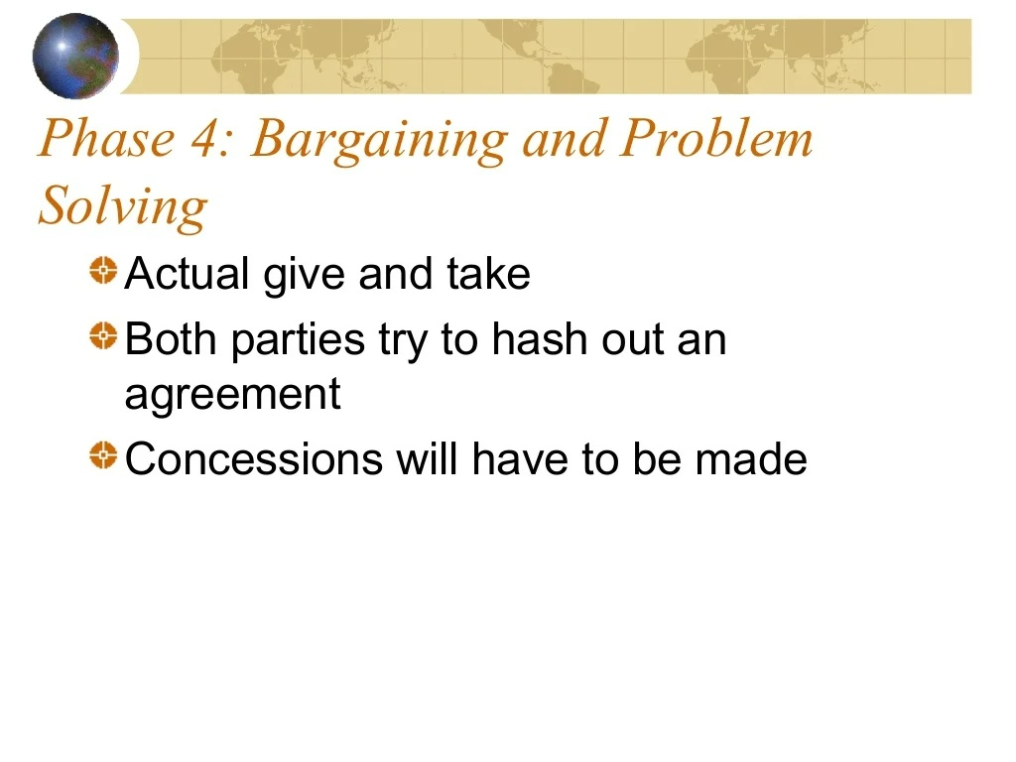

Slide 48
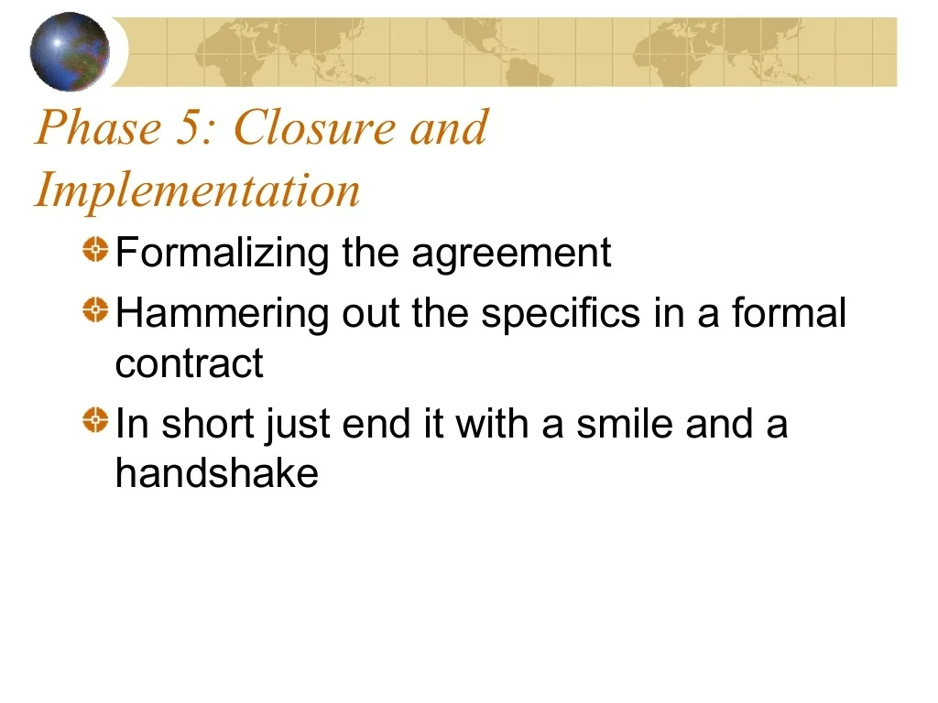

Slide 49
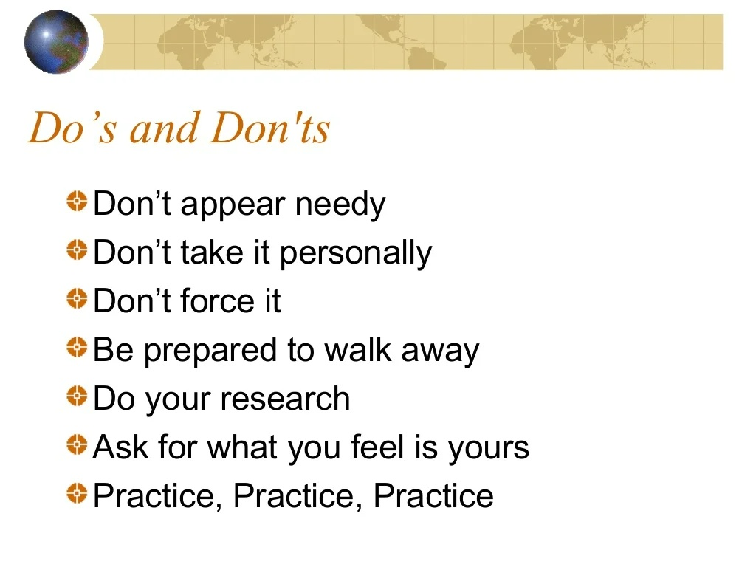

Slide 50
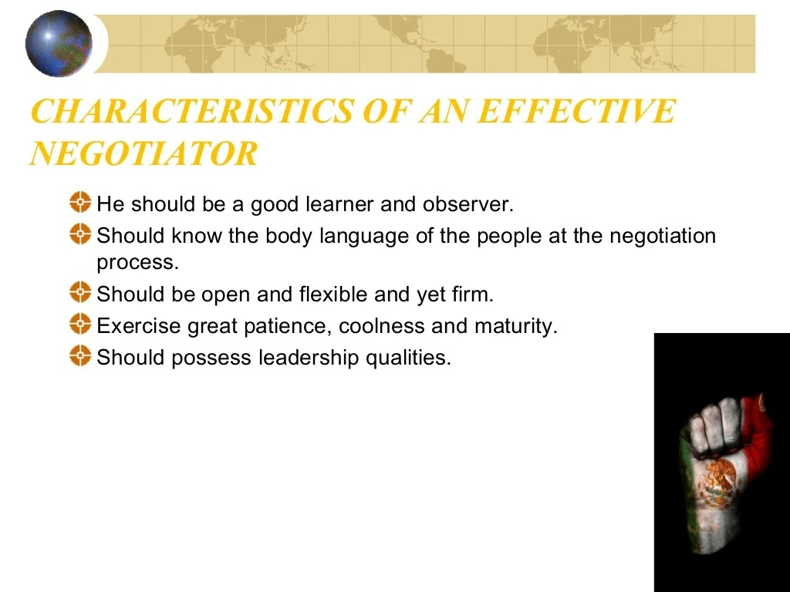

Slide 51


Slide 52


Slide 53


Slide 54


Slide 55


Slide 56


Slide 57


Slide 58


Slide 59


Slide 60


Slide 61


Slide 62


